Slide 1
The Impulse-Momentum Theorem for a Rigid Body
Dr. Jacob Moore
Associate Professor of Engineering
Penn State Mont Alto

Slide 2
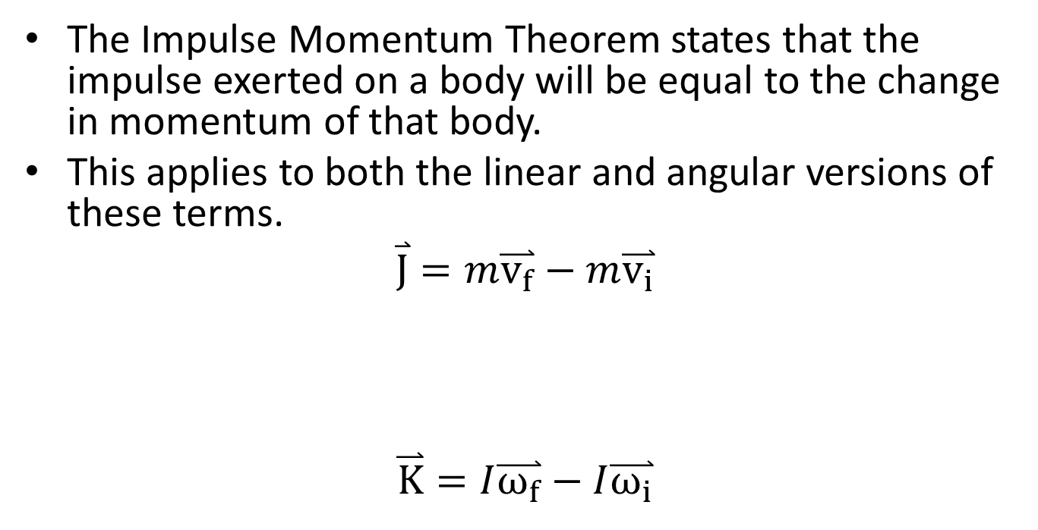
Impulse and Momentum in a Rigid Body
The Impulse Momentum Theorem states that the impulse exerted on a body will be equal to the change in momentum of that body.
This applies to both the linear and angular versions of these terms.
$$\overset{⃑}{J}=m\overset{⃑}{v_{f}}−m\overset{⃑}{v_{i}}$$
$$\overset{⃑}{K}=I\overset{⃑}{ω_{f}}−I\overset{⃑}{ω_{i}}$$
Linear Impulse
Initial Linear Momentum
Final Linear Momentum
Angular
Impulse
Initial Angular Momentum
Final Angular Momentum

Slide 3
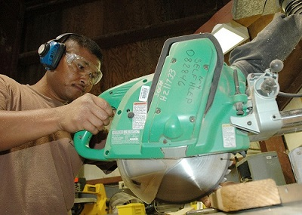
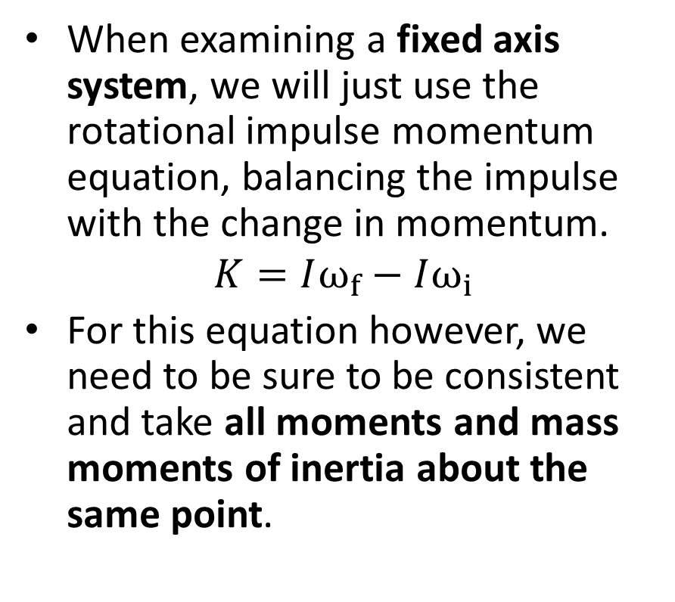
Fixed Axis Rotation with the Impulse Momentum Equations
When examining a fixed axis system, we will just use the rotational impulse momentum equation, balancing the impulse with the change in momentum.
$$K=Iω_{f}−Iω_{i}$$
For this equation however, we need to be sure to be consistent and take all moments and mass moments of inertia about the same point.
Public domain image by John F. Looney

Slide 4
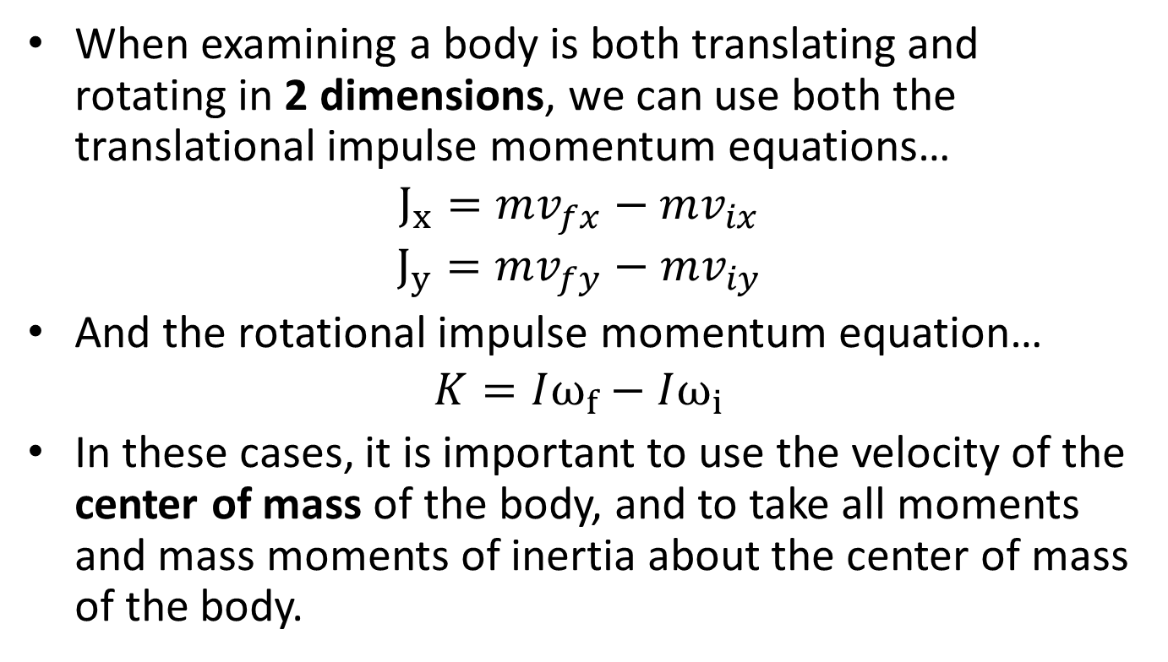
General Planar Motion with the Impulse Momentum Equations
When examining a body is both translating and rotating in 2 dimensions, we can use both the translational impulse momentum equations…
$$J_{x}=mv_{fx}−mv_{ix}$$
$$J_{y}=mv_{fy}−mv_{iy}$$
And the rotational impulse momentum equation…
$$K=Iω_{f}−Iω_{i}$$
In these cases, it is important to use the velocity of the center of mass of the body, and to take all moments and mass moments of inertia about the center of mass of the body.

Slide 5





Solving Impulse Momentum Problems
Just as we did with particle systems, the first step in solving the problem is set up a diagram showing the initial and final states as well as any forces and moments causing an impulse between those two states.
$$ω_{i}=1 rad/s$$
$$ω_{f}=2 rad/s$$
m = 3kg
m = 3kg
$$v_{i}=3m/s$$
$$v_{f}=2.5 m/s$$
$$F_{friction}$$

Slide 6
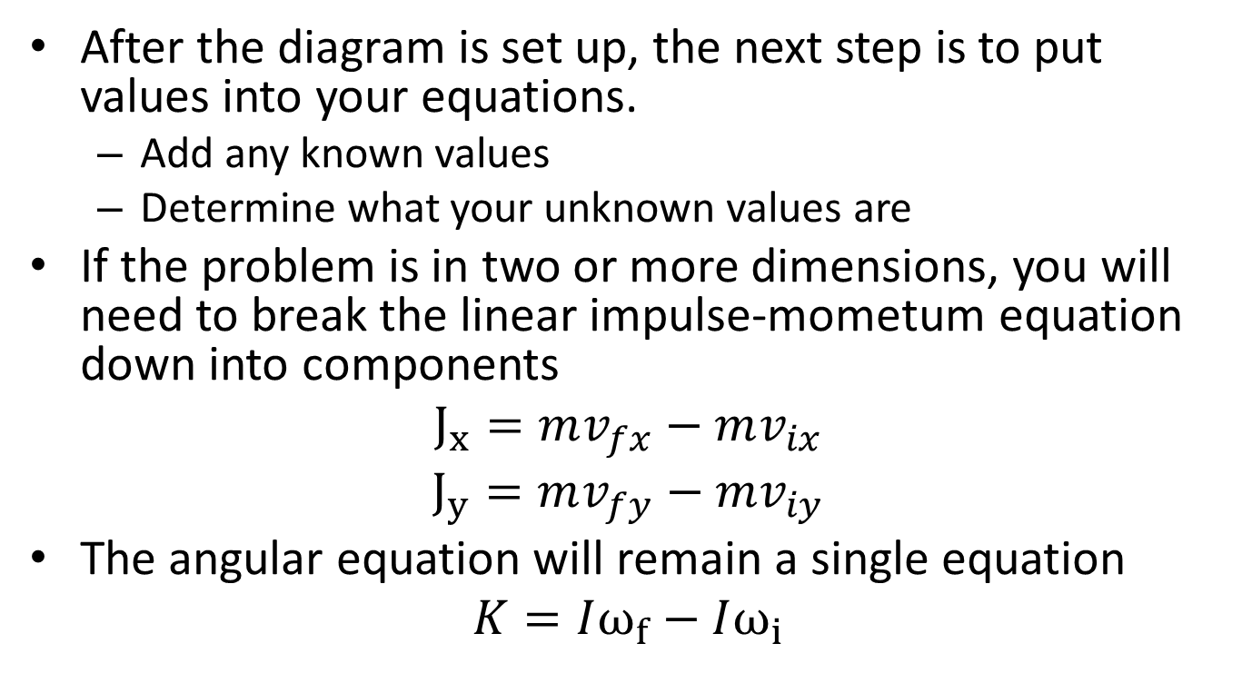
Solving Impulse Momentum Problems
After the diagram is set up, the next step is to put values into your equations.
Add any known values
Determine what your unknown values are
If the problem is in two or more dimensions, you will need to break the linear impulse-mometum equation down into components
$$J_{x}=mv_{fx}−mv_{ix}$$
$$J_{y}=mv_{fy}−mv_{iy}$$
The angular equation will remain a single equation
$$K=Iω_{f}−Iω_{i}$$

Slide 7
Solving Impulse Momentum Problems
Finally, the last step is to solve your equations for any unknowns.
Make sure you have at least as many equations as unknowns
You may need relate linear and angular values with kinematics
The equations should not be too complicated but use equation solvers if necessary.

Slide 8
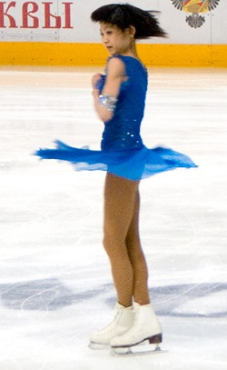
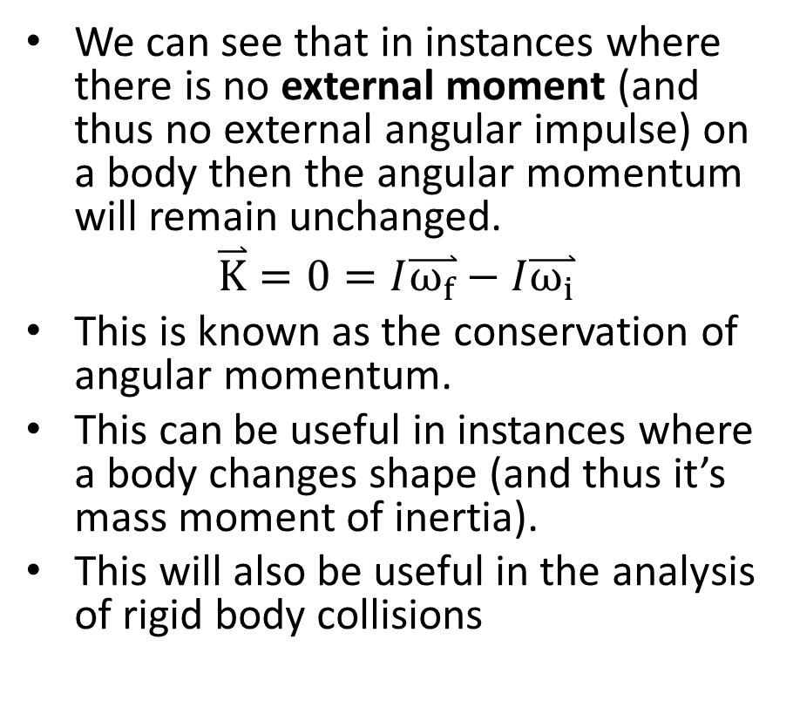
The Conservation of Angular Momentum
We can see that in instances where there is no external moment (and thus no external angular impulse) on a body then the angular momentum will remain unchanged.
$$\overset{⃑}{K}=0=I\overset{⃑}{ω_{f}}−I\overset{⃑}{ω_{i}}$$
This is known as the conservation of angular momentum.
This can be useful in instances where a body changes shape (and thus it’s mass moment of inertia).
This will also be useful in the analysis of rigid body collisions
Public Domain image by deerstop

Slide 9
Thanks for Watching
See other engineering mechanics videos and access the full tool at…

Slide 10
Worked Example
A miter saw has an operating speed of 1500 rpm. The blade and motor armature have a combined weight of 3 lbs and a radius of gyration of 1 inch.
What is the time required for the bearing friction alone (T=.015 in lbs) to stop the blade?
What is the torque a braking system would need to apply to stop the blade in just .25 seconds?
Public domain image by John F. Looney

Slide 11
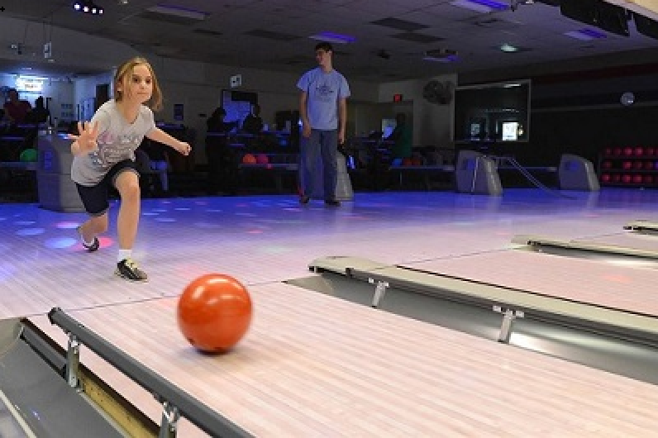
Worked Example
A bowling ball is modeled as a 7 kg uniform sphere 300 mm in diameter. The ball is released with an initial velocity of 6m/s on a horizontal wooden floor (𝜇_{k}=.1) with zero angular velocity.
How long does it take before the ball begins to roll without slipping?
What is linear velocity of the ball at this time?
Public domain image by Jerry Saslav

Slide 12
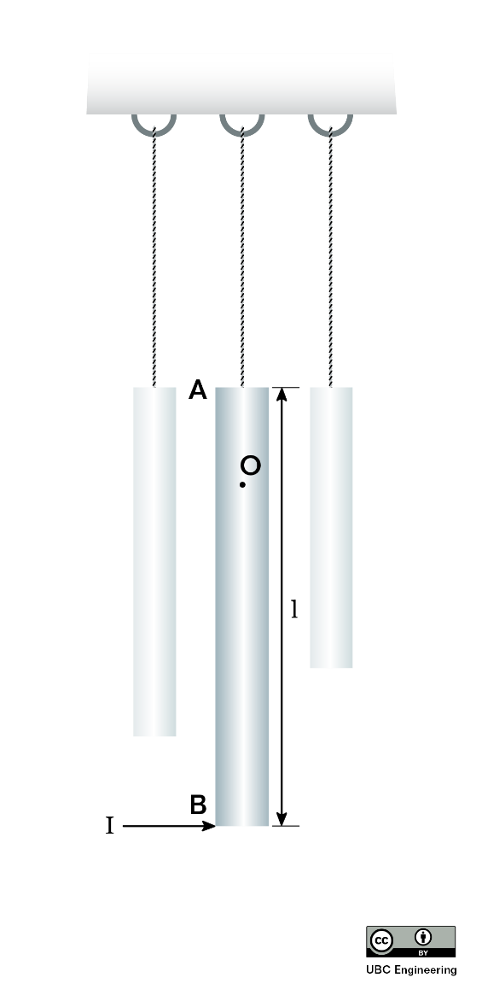
Worked Example
A windchime consists of several slender rods, each suspended on one end by a rope and each with mass m. Consider a singular rod for this problem. As the wind blows, the rod is subjected to an impulse I at its bottom. Determine the vertical location of point O in which the rod appears to rotate.

Slide 13
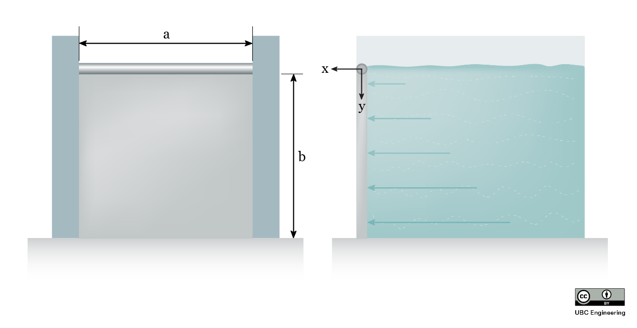
Worked Example
A salmon hatchery has a gate to release water whenever water levels get too high. The gate is normally locked into place, but when the water reaches. The top of the gate, the lock is instantly removed. While the water would flow out of the gate by itself, there is a pump located upstream from the gate to push water forward. The pump is old, so its power slowly ramps up with time. The gate consists of a slender rod in which a 20 kg thin plate is attached. The plate has dimensions a=1.5 m,b=2 m and rotates about the slender rod as if it were a pin. Although there is a seal such that water may not get out, assume the contact between the plate and other surfaces is frictionless. If the gate is subject to water from the pump that applies a force distribution with a magnitude that is related to both the y-coordinate and time dF=(-t(y-2)^2+8t) dy N, determine the angular velocity of the gate after t=2 seconds if the gate initially starts at rest.

Slide 14
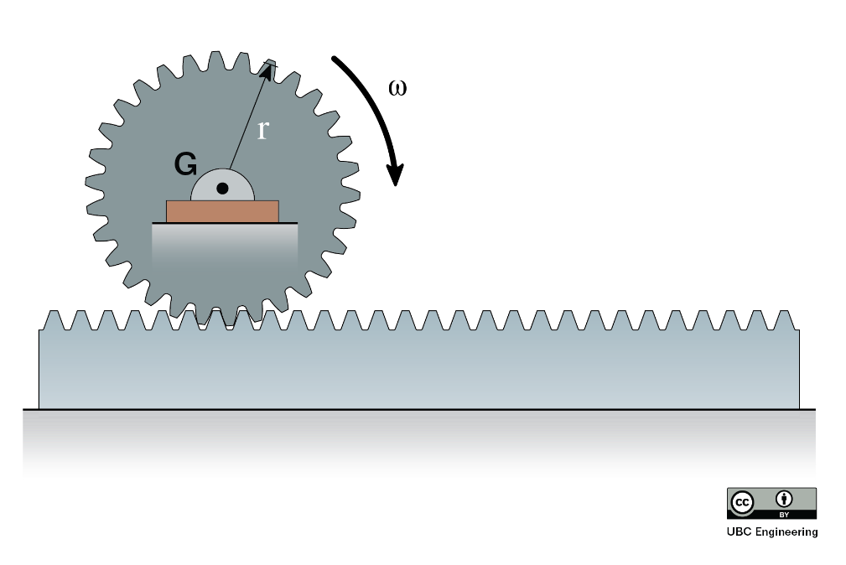
Worked Example
A city engineer is working on a cargo transport system utilizing gears and racks. She is considering a 30 kg gear with a radius of gyration of k_{G} = 125 mm and a radius of r = 0.15 m. The gear is in contact with a 20 kg rack. If it takes the gear 0.6125 s to reach an angular velocity of ω = 20 rad/s, starting from rest, determine the moment that the gear is subjected to. Assume there is no friction between the rack and the ground.

Slide 15
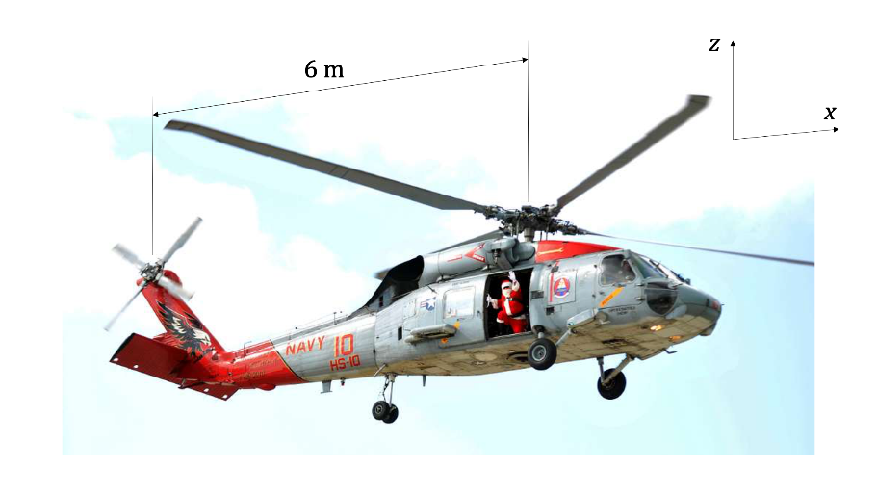
Worked Example
A helicopter tail rotor is used to prevent unwanted rotation of the body of the helicopter when the main rotor changes speed. Assume that the four main rotor blades are each long thin rods with length of 5 m and mass of 30 kg. Assume that the helicopter body has a mass of 750 kg and a mass moment of inertia of 1300 kg-m² at its center of gravity, located vertically in line with the main rotor. The distance between the main and tail rotors is 6 m.
If the tail rotor is functioning, and the angular velocity of the helicopter body remains at zero before and after the main rotor changes speed from 200 rpm to 300 rpm, find the final horizonal velocity of the helicopter body (starts from rest).
Assuming the main rotor change in speed from 200 rpm to 300 rpm occurs in uniformly over 8 s, find the force exerted by the tail rotor to keep the helicopter body from turning.

